Slide 1

Top-Down Feedback for Crowd Counting Convolutional Neural Network
Deepak Babu Sam and R. Venkatesh Babu
Video Analytics Lab, Indian Institute of Science,
Bangalore 560012, INDIA
VTS
Reporter:王倩

Slide 2
Related Work
Introduction
Architecture
Experiment
VTS
Analysis

Slide 3
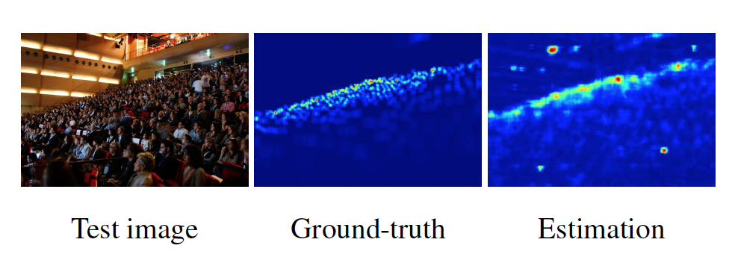
Crowding Counting
VTS

Slide 4
Related Work
Early works ：2011 ，head detections（appearance features）
crowd counting
2013 Idrees ， use HOG based head detectors, SIFT interest point vectors and Fourier transform features to regress the count.
2015，Zhang, train a counting CNN by alternatively backpropagating crowd density loss and crowd count loss.
2015， Wang ，a deep CNN is employed to regress directly the crowd count instead of a density map. high error rates
2016， Onoro-Rubio， feed images at different scales to separate CNNs
2016， Zhang ， use three columns of CNN having different filter sizes to capture crowd scenes at multiple scales
VTS

Slide 5
Related Work
However, these incur lot of false detections
Because of the absence of high-level context information to the lower layers of the CNN regressor
VTS

Slide 6
Related Work
Feedback in the form of multiplicative gating. The final prediction is output by the bottom-up network using the feedback gated activations.
VTS

Slide 7
Introduction
Q1:
1. Extremely dense crowds, people occupy only few pixels
2. People are seen as bunch of blobs
3. Occlusion, pose changes, view-point variations and illumination conditions
4. Making it difficult to individually detect and count people
crowd features √ head-shoulder pair
individual human features × facial features like eyes or nose
A1:Convolutional Neural Networks (CNN) regressor regress crowd density(number
of people per unit area)
VTS

Slide 8
Q2: CNN regressor as a bottom-up network ,causing:
1. Low-level feature detectors do not have enough context
information to decide on the input.
2. Many crowd like patterns in the image created by leaves
of trees, buildings, cluttered backgrounds etc.
3. High level context information indicate these are irrelevant
patterns, losing useful information in the initial layers ,causing
misclassified as people.
A2: The top-down feedback mechanism ( use high-level
context information to correct false density predictions of the counting CNN. )
VTS

Slide 9
Introduction
In summary, the major contributions of this paper :
• A generic architecture to deliver top-down information in
the form of feedback to the bottom-up network.
• A crowd counting system that uses top-down feedback
framework to correct its density predictions.
VTS

Slide 10
Architecture
Architecture ：A bottom-up CNN
Separate top-down CNN -> generate feedback.
VTS

Slide 11
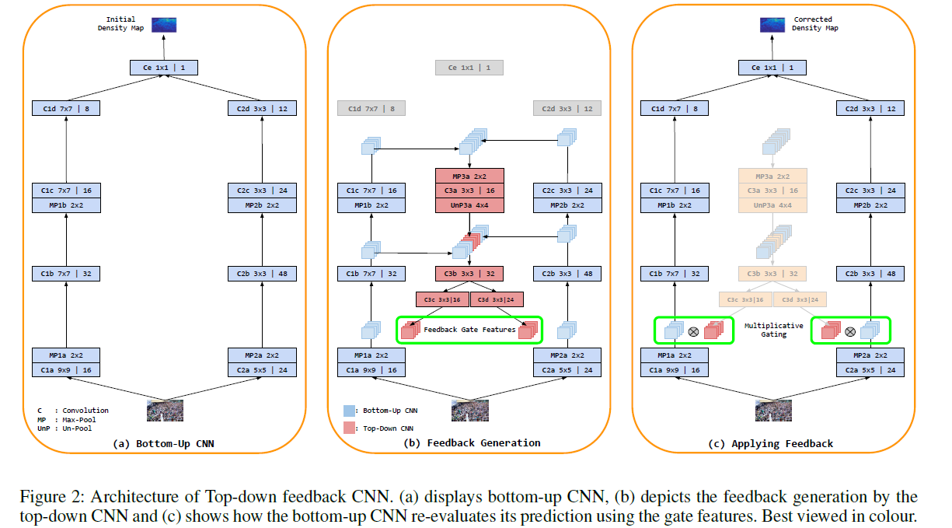
Architecture
• The bottom-up network regresses the crowd density map, has two columns of CNN with different receptive fields, generated features from various layers .
Two column CNN

Slide 12
Architecture
• The top-down network generated multiplicative gating as the activations of the bottom-up network to correct the density prediction.

Slide 13
Architecture
Top-Down Feedback CNN
High-level feature maps from the bottom-up network to generate feedback .
The feature maps are taken from the layers immediately before pooling layers of the bottom-up CNN.

Slide 14
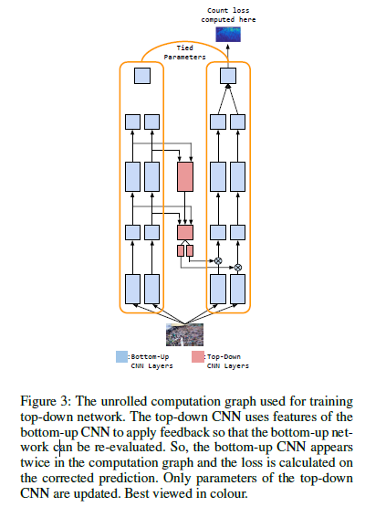
Architecture
The unrolled computation graph used for training
top-down network.

Slide 15
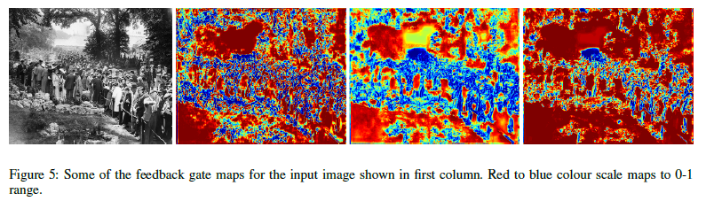
VTS

Slide 16
Architecture
Training of Bottom-Up CNN
The bottom-up network is pre-trained
Both columns of the bottom-up network are individually pretrained.
VTS

Slide 17
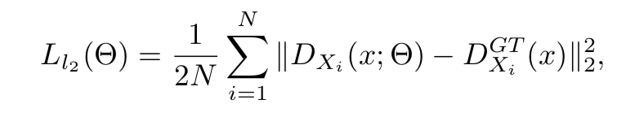
Architecture
Training of Bottom-Up CNN
Loss ：
VTS

Slide 18
Architecture
Training of Top-Down CNN
After bottom-up network is trained, its parameters are fixed.
While training, only the parameters of the top-down network are updated.
VTS

Slide 19
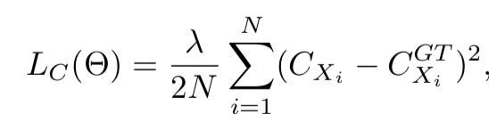
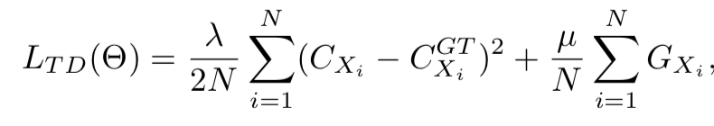
Architecture
Loss
（scalar GXi is the sum of all feedback gate features）
add l1 regularizer, the final loss function
VTS

Slide 20


Experiment
Evaluation Scheme
Mean Absolute Error(MAE):
Mean squared error(MSE):
VTS

Slide 21
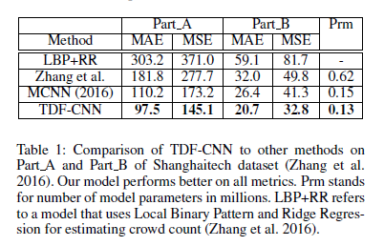
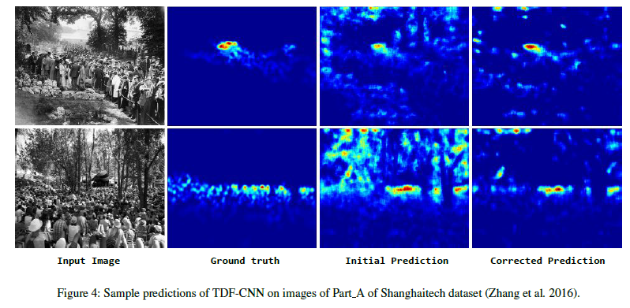
Experiment
Crowd counting datasets
1.Shanghaitech dataset
VTS

Slide 22
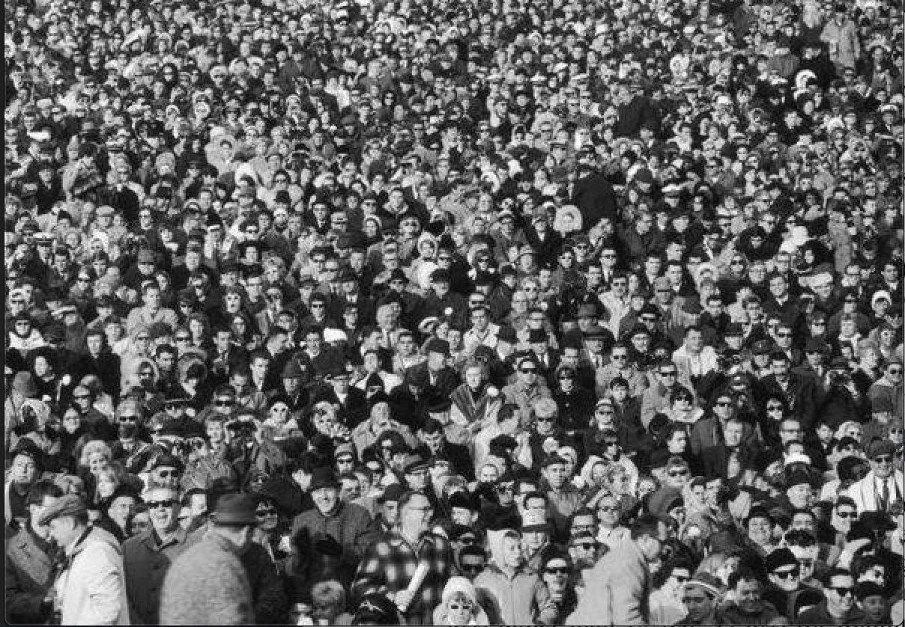
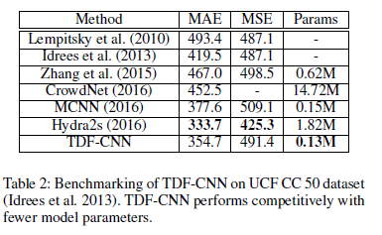
Experiment
Crowd counting datasets
2. UCF CC 50 dataset
VTS

Slide 23
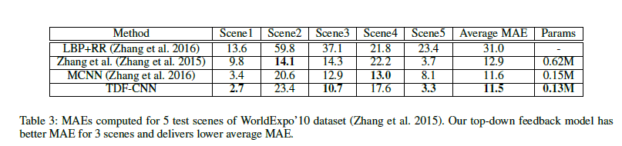
Experiment
Crowd counting datasets
3. WorldExpo’10 dataset
VTS

Slide 24
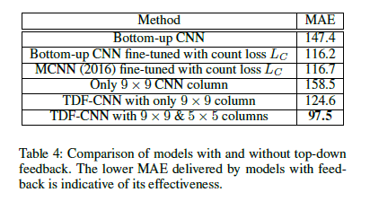
Analysis
Comparison of models
VTS

Slide 25
Analysis
VTS

Slide 26
Conclusion
Typical crowd counting CNNs are trained to look for crowd patterns
High-level scene context to correct spurious detections
VTS

